Slide 1
EEG-Based Analyzing Human Idiosyncrasies Within Unpredictable Circumstances Using 3D Convolutional Neural Networks

Slide 2
PRESENTED BY:
Supervised By:
Rufaida Tasin- 15201031
Tanzim Ahmed- 15201040
Sabbir Al Fahad- 16301191
Abu Sayed Bin Abdullah- 15301053
Joy Paul- 15301074
Muhammad Iqbal
Hossain, PhD
Assistant Professor,
Computer Science and Engineering,
BRAC University.

Slide 3
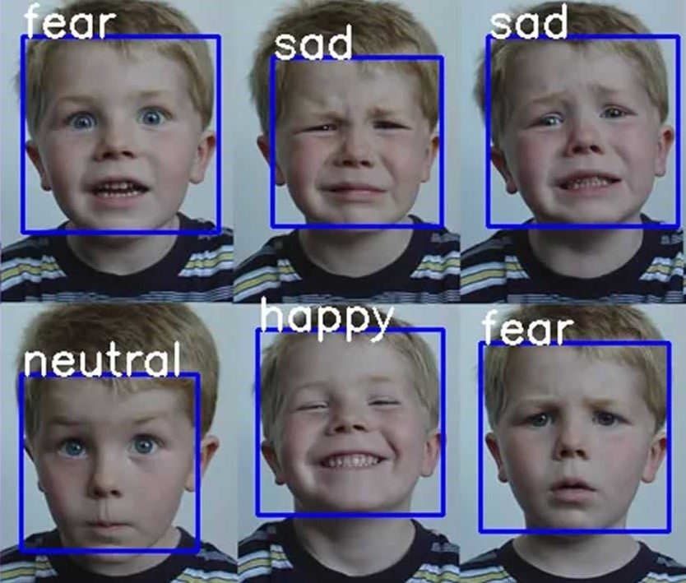

Slide 4




Detected Emotions
Happy
Sad
Neutral
Fear

Slide 5
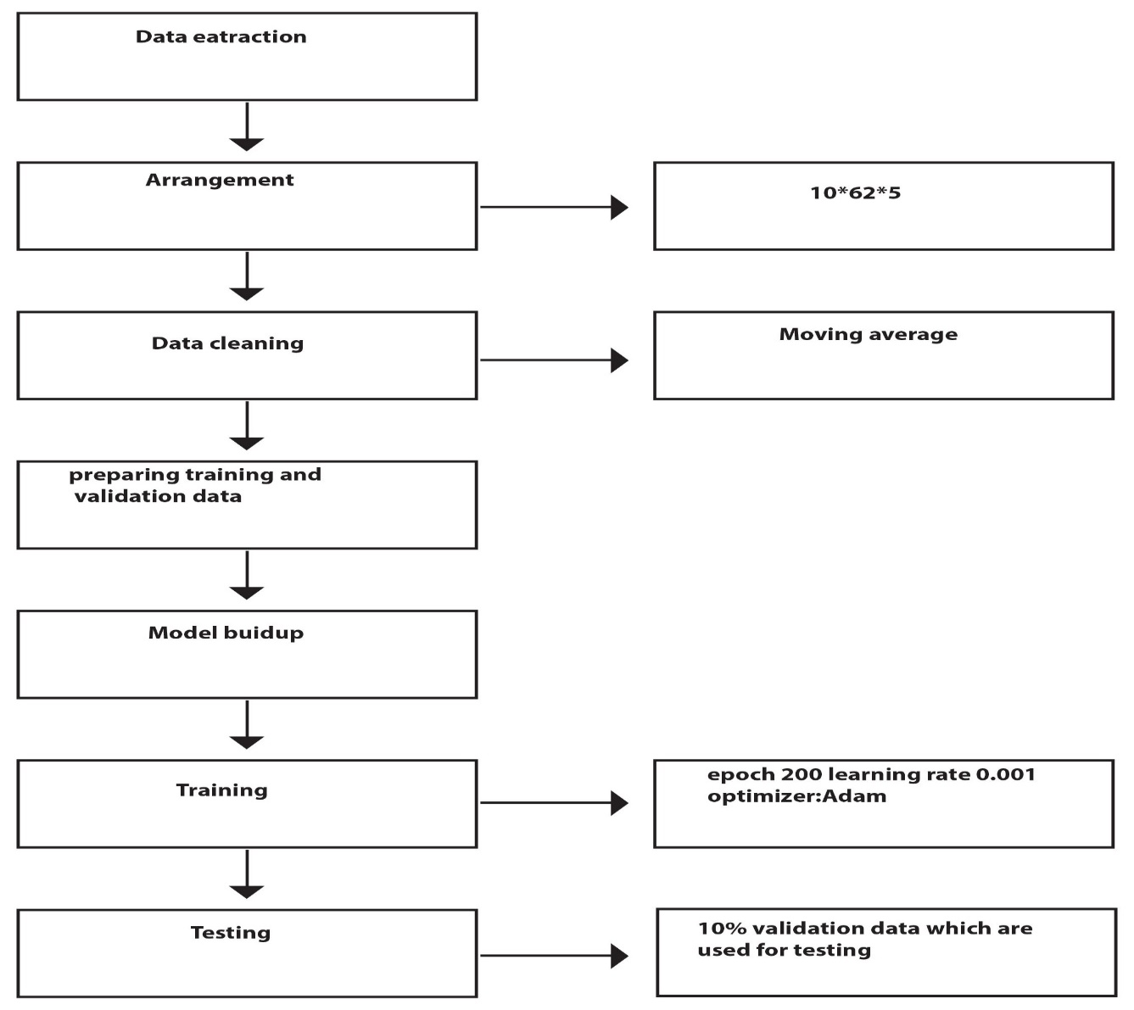
Workflow

Slide 6
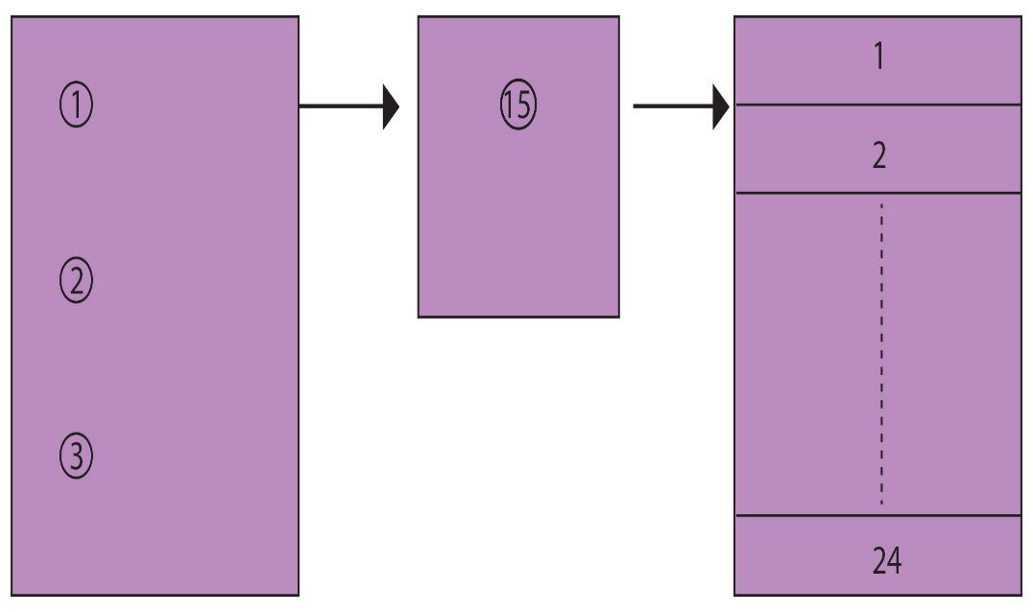
Dataset description
Total 15 participants
3 sessions
24 trails
62 channels
PSD , DE

Slide 7
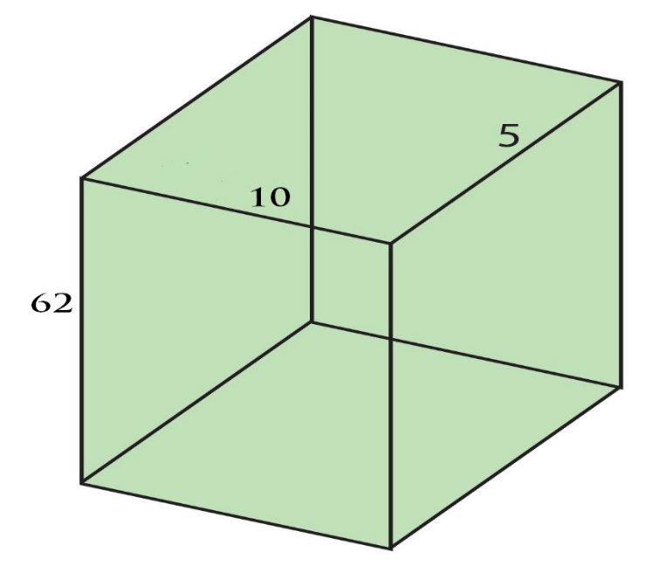
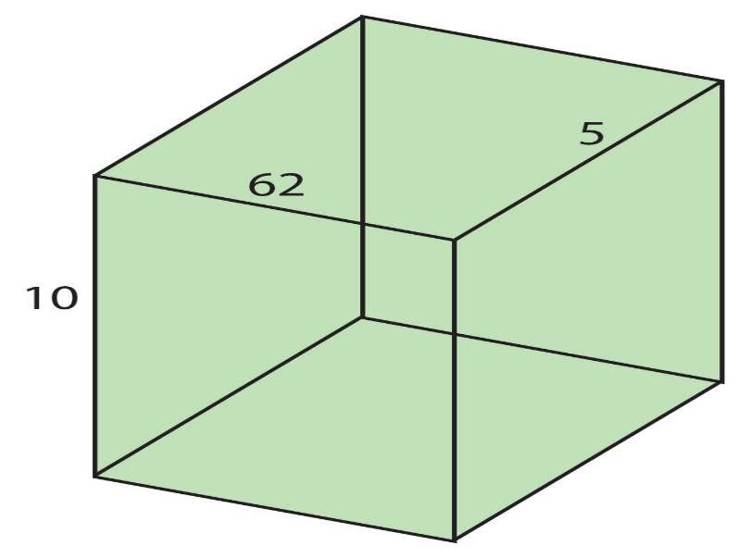
DATA ARRANGEMENT & CLEANING
Used moving average for reducing noise
62x10x5 → 10x62x5

Slide 8
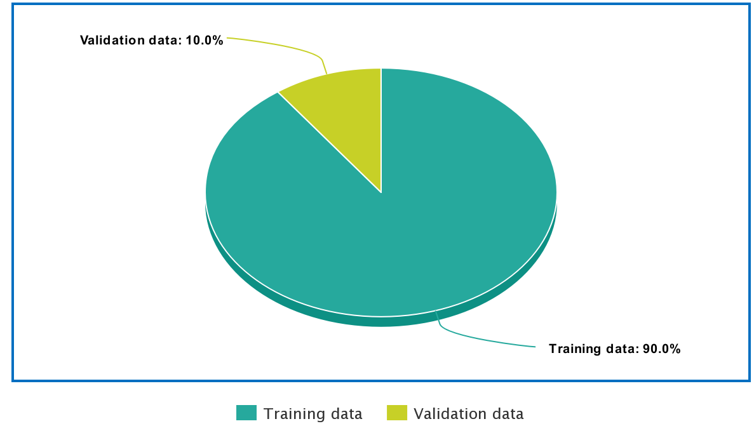
Training and validation data
Learning Rate 0.001
Batch 200
Epoch size 30
Training data: 90%
Validation data: 10%

Slide 9
Model Build Up
3D Convolutional Neural Networks
3D Conv.
Kernel
(1,3,1)
PSD
3D Conv.
Kernel
(1,3,1)
DE

Slide 10
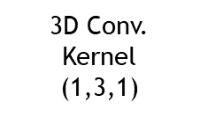
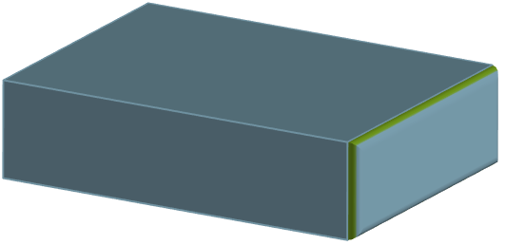


Model Build Up Concatenation
3D Conv.
Kernel
(1,3,1)
Resultant Tensor
3D Conv.
Kernel
(1,3,1)
3D Conv.
Kernel
(1,3,1)
Concatenation

Slide 11
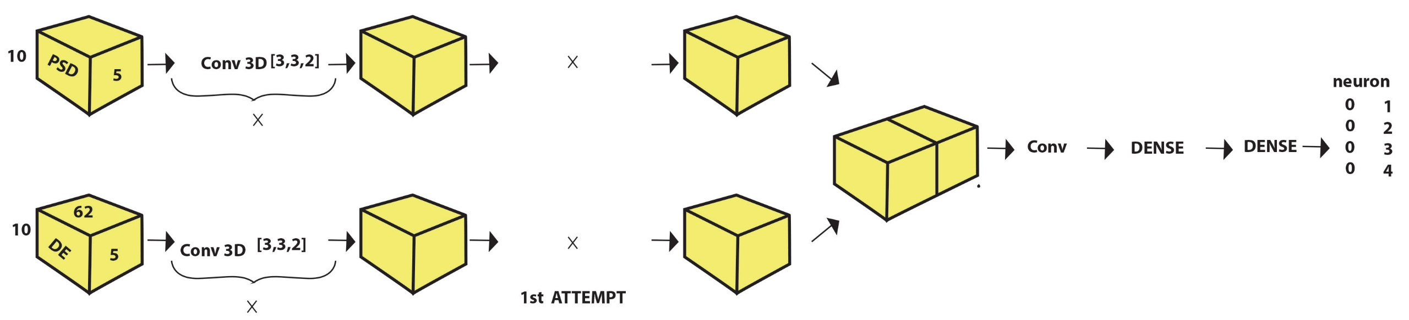
Model Buildup First 1st Attempt
30% Accuracy

Slide 12
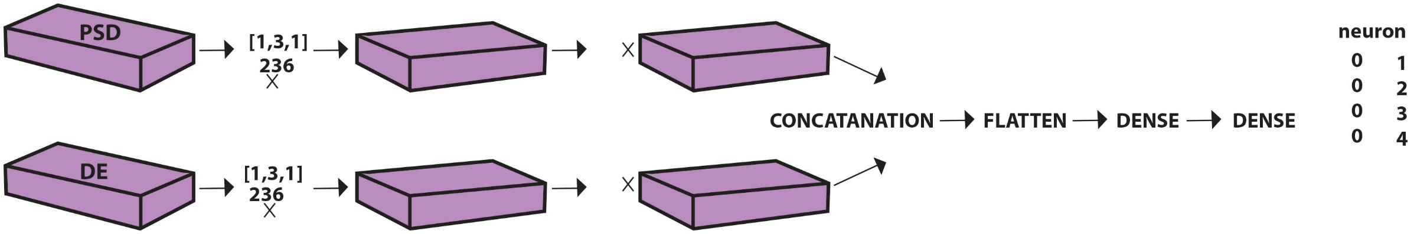
Model Buildup First 2nd Attempt
69.78% Accuracy

Slide 13
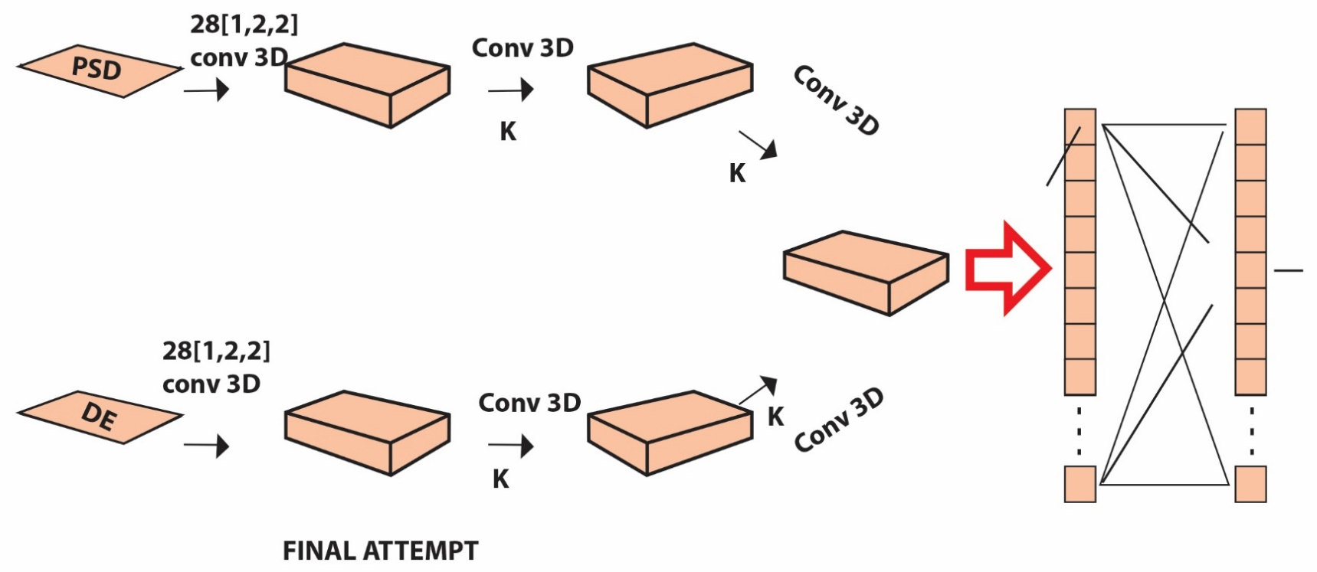
Final Model

Slide 14
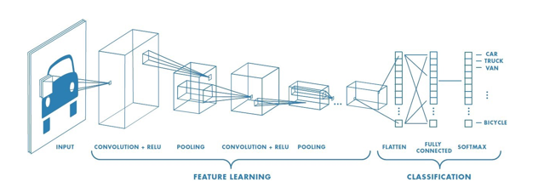
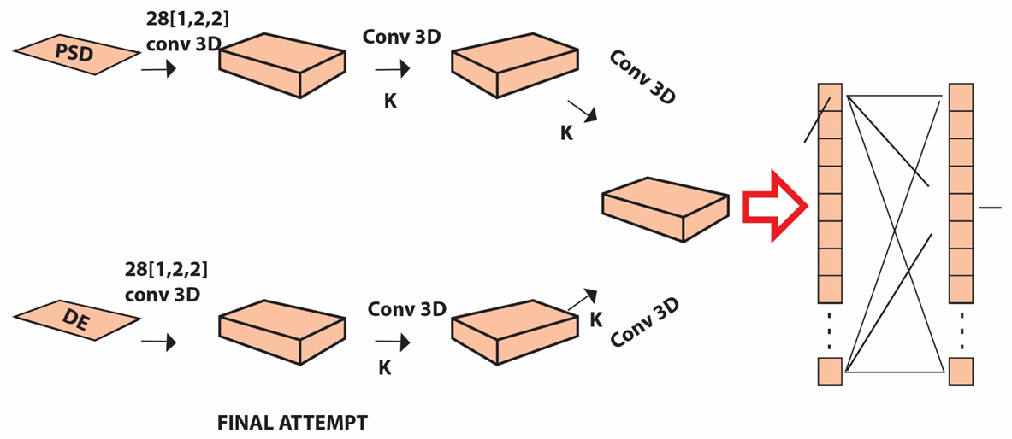
Siamese Neural Network
One shot classifier
Has advantages for less training data

Slide 15
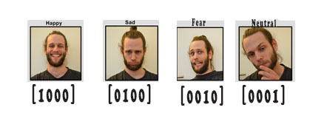
Categorical Cross-entropy (loss Function)
Minimizes the distance between two probability distributions
compares the model's prediction

Slide 16
Adam Optimizer
Cursed breaker for small dataset
Fast as Adam
Optimize accuracy to the last bit of data

Slide 17
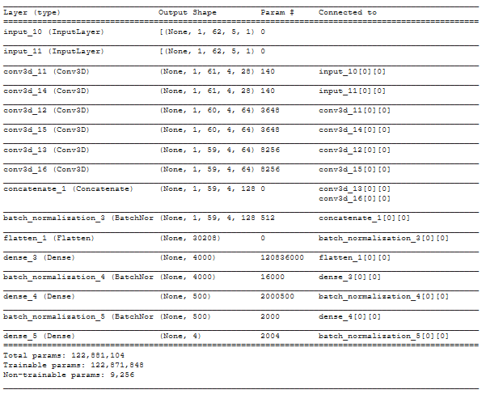
Summary

Slide 18
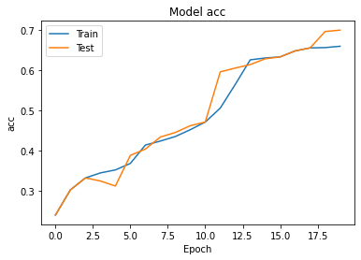
Result
Final output 70% accuracy.

Slide 19
Drawbacks
Could not collect Enough data
Hardware support
Lack of communication due to COVID-19

Slide 20
Future Improvement
Train the model with more data
Upgrade the model
Use highly configured device

Slide 21
Thank You

